Slide 1
Truck Platooning: SVM Line Following and
Formal Verification with UPPAAL
Autonomous Systems A Lab, Team 5
Iko-ojo Victor Odaudu · Hany Chowdhury · Muhammad Mujhtaba Qaiser

Slide 2
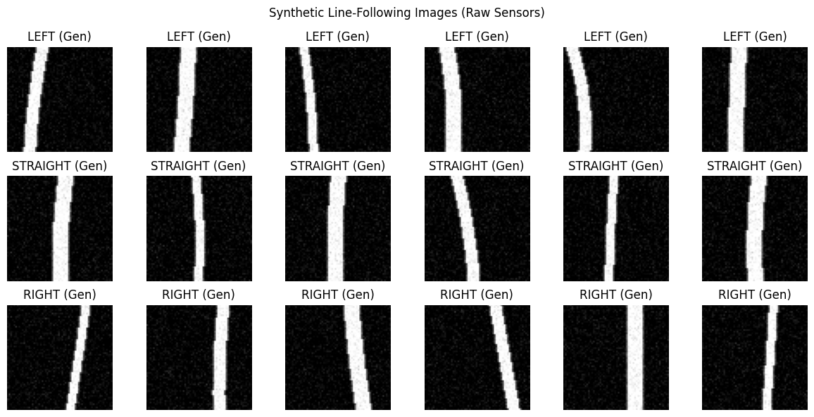
Machine Learning: SVM Line Following
Steering from the line camera
started with 3 classes later changed to 5
One feature: line offset from centre
SVM (RBF) + GridSearchCV
Trained on synthetic + data from the science truck
Synthetic training samples (left / straight / right)

Slide 3
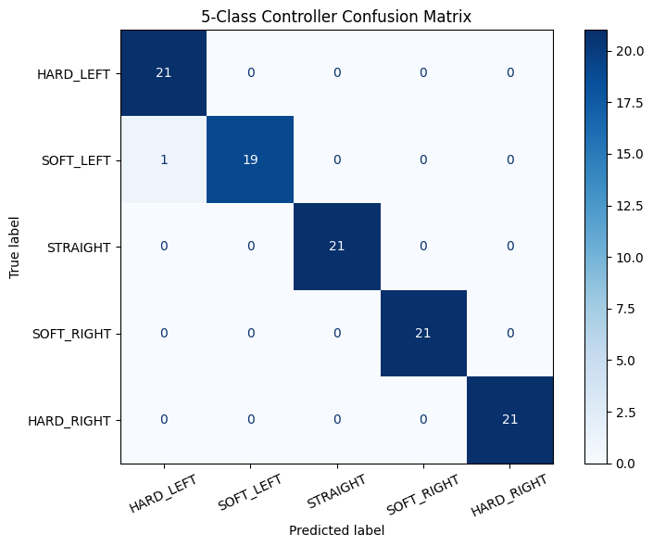
Machine Learning Results
99%
accuracy (5 balanced classes)
Classes balanced to 104 each
Prevents bias toward STRAIGHT
Almost no class confusion
5-class confusion matrix (test set)

Slide 4
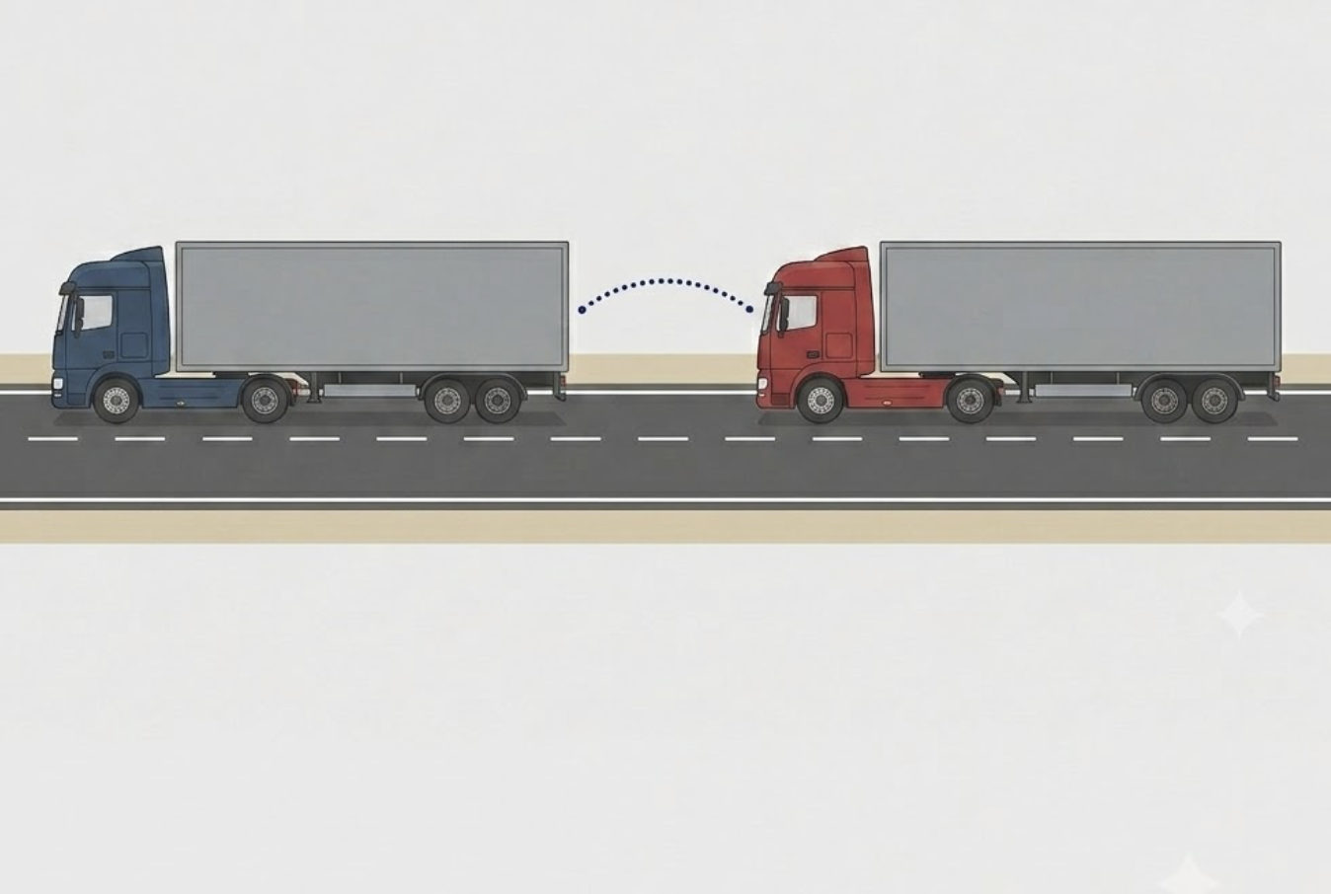
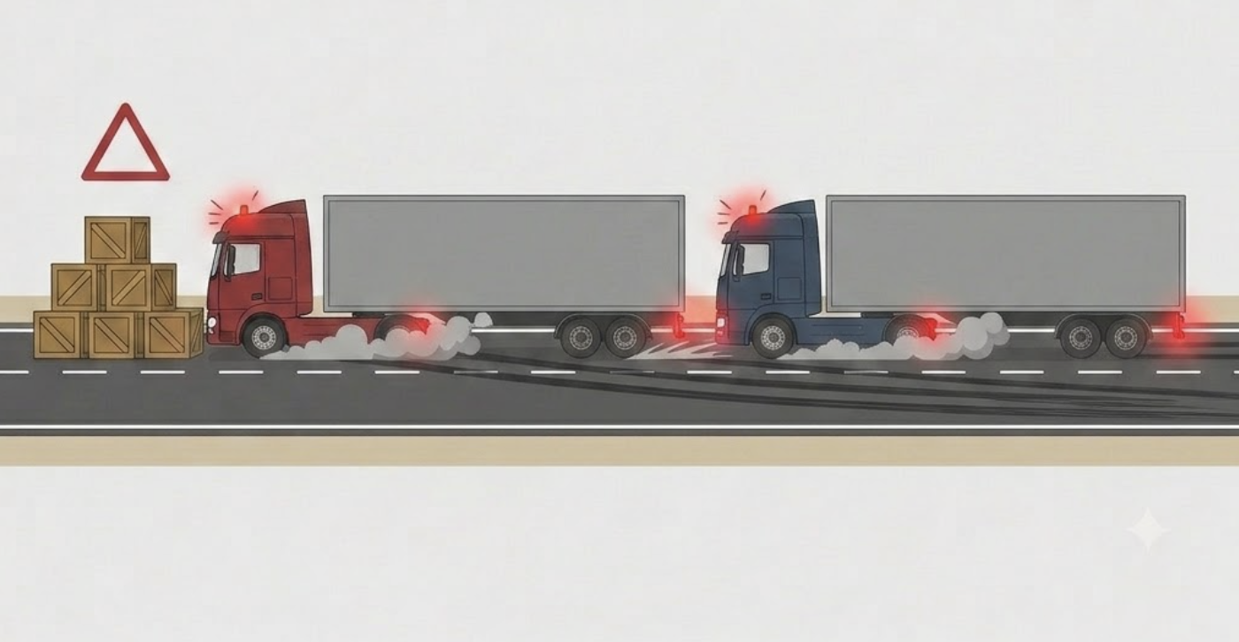
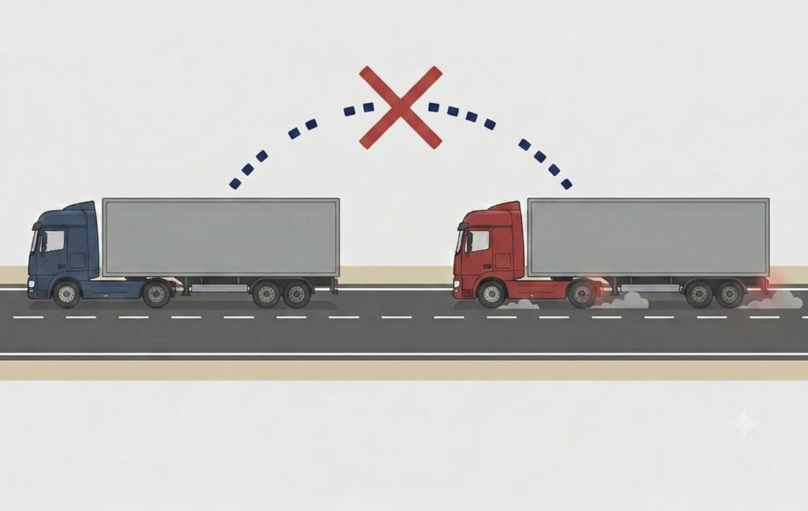
Platooning: Three Scenarios
Normal Platooning
Communication Failure
Emergency Braking
Follower tracks the leader at a safe distance
Wireless link drops, follower enters fallback
Obstacle ahead, redundant braking paths
All 3 illustrations are AI generated by gemini’s nanobanana

Slide 5
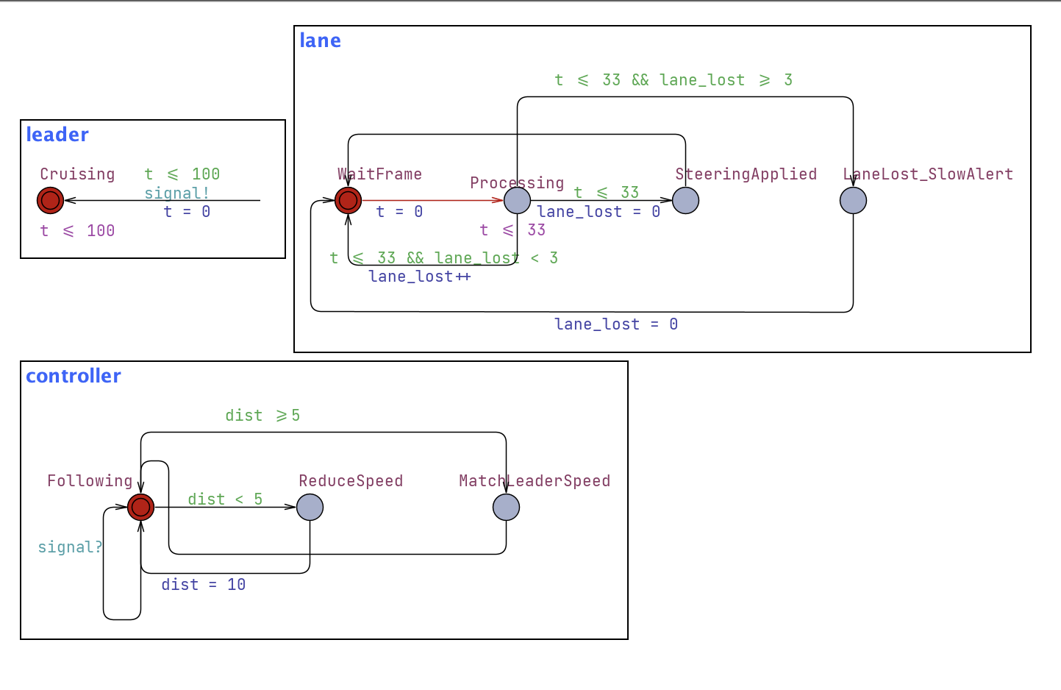
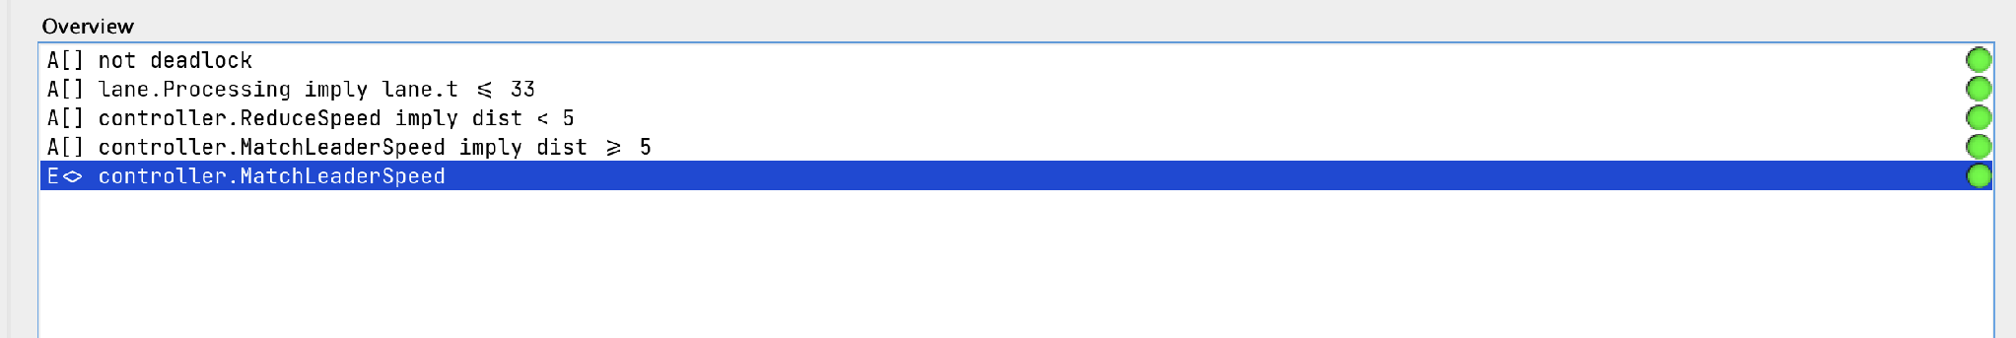
Scenario 1: Normal Platooning
Leader sends speed + position
Follower keeps safe 10m target 5m minimum
Leader loops sending the signal
Lane detection processes each frame (≤ 33 ms)
Controller reduces speed if too close, else matches
UPPAAL model
Verification: deadlock-free, all queries satisfied

Slide 6
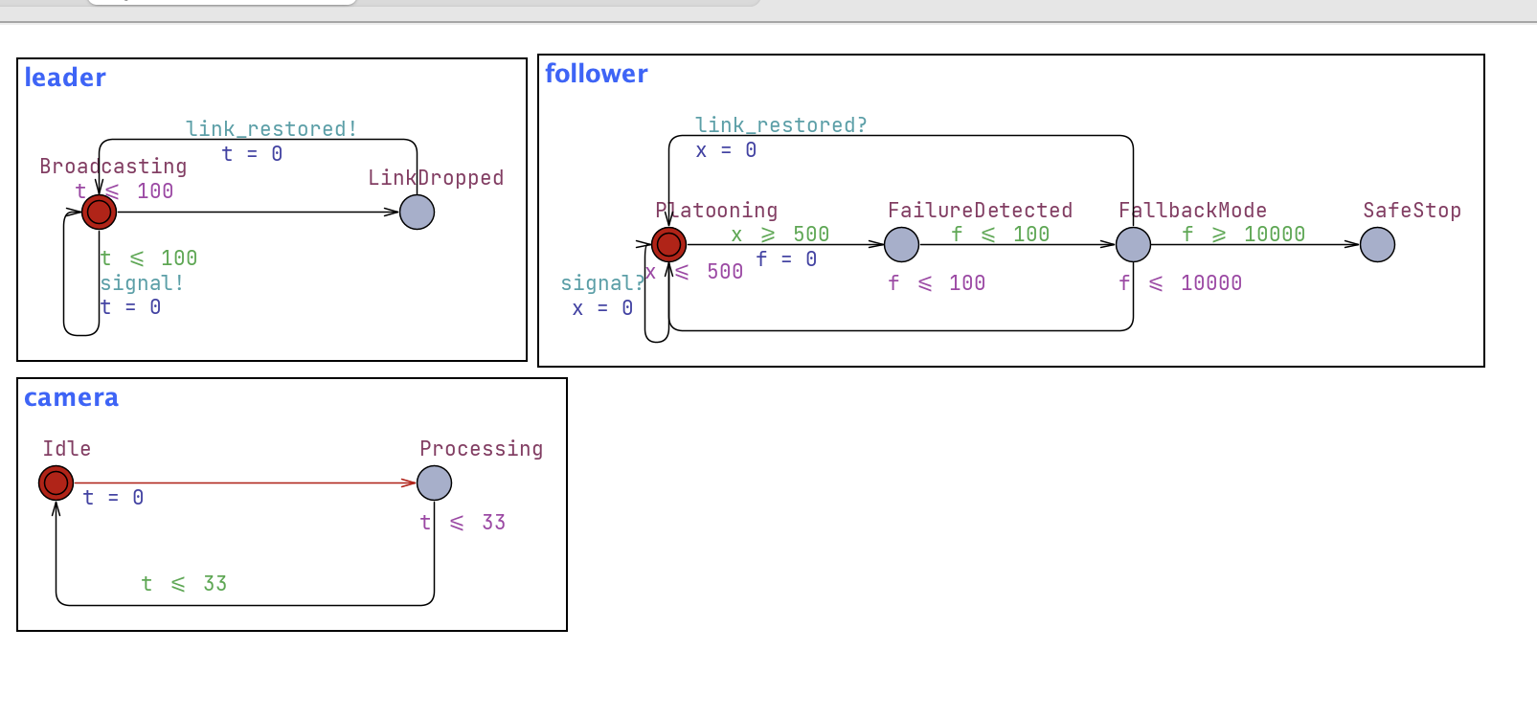
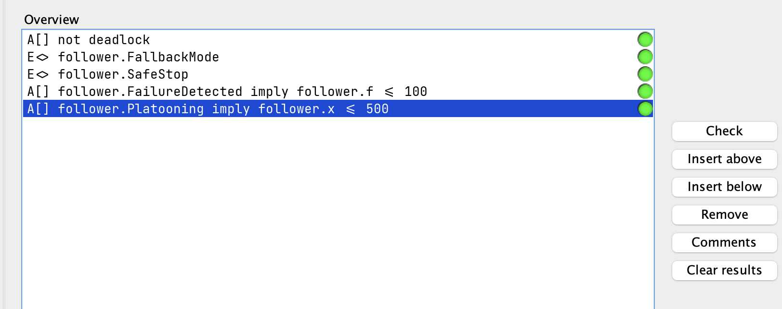
Scenario 2: Communication Failure
Link drops, failure detected within 500 ms
Fallback within 100 ms, full stop at 10 s
Follower: Platooning -> FailureDetected -> FallbackMode -> SafeStop
Clock x times out at 500, clock f runs the fallback
Camera loops independently, lane keeping stays on
UPPAAL model
Verification: deadlock-free, all queries satisfied

Slide 7
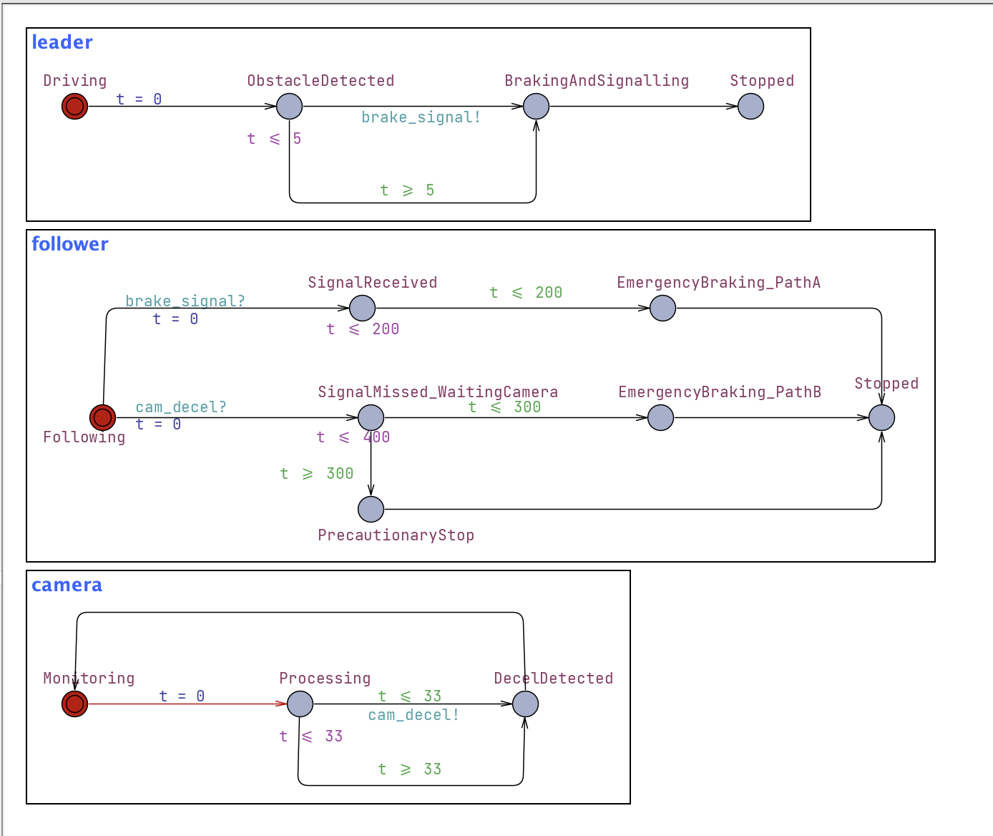
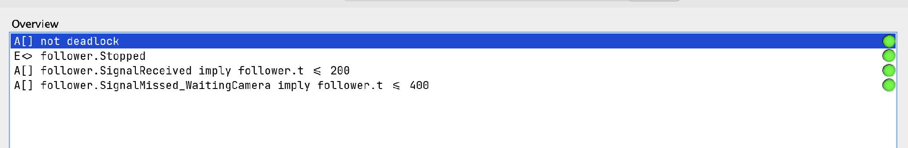
Scenario 3: Emergency Braking
Obstacle ahead, leader brakes and signals
Three braking paths, no single point of failure
Path A: signal received → brake ≤ 200 ms
Path B: camera detects → brake ≤ 300 ms
Path C: precautionary stop by 400 ms
UPPAAL model, three braking paths
Verification: deadlock-free, all queries satisfied

Slide 8
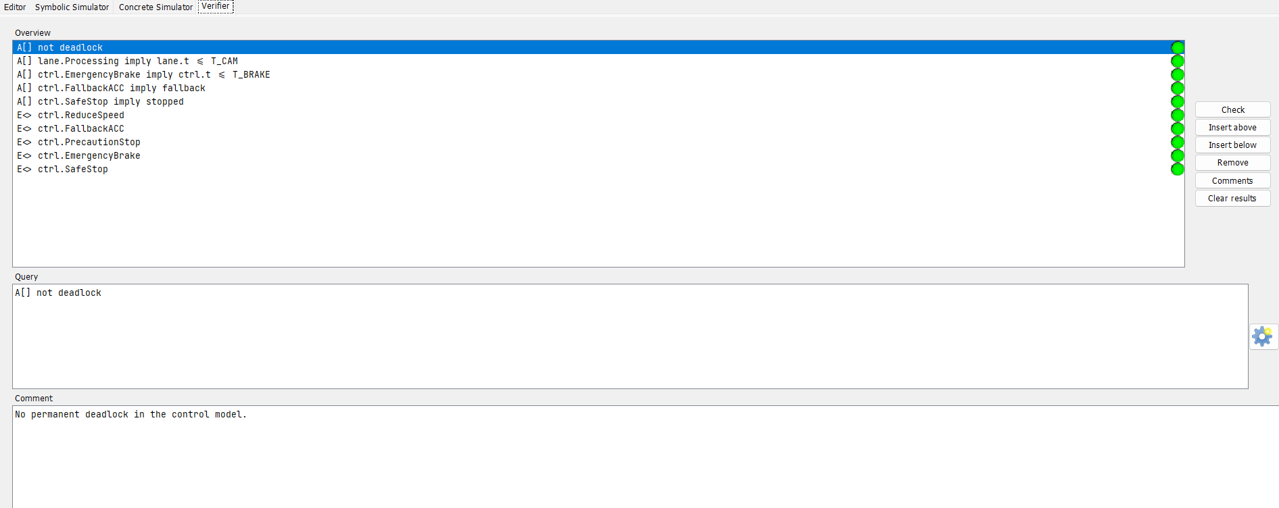
Task 4: Verification
– all queries pass
– No deadlock
Unsafe distance is detected and corrected by ReduceSpeed or EmergencyBrake.
– dist < minimum triggers a safe control response
Task 4 verifier image
Verification results, deadlock-free

Slide 9
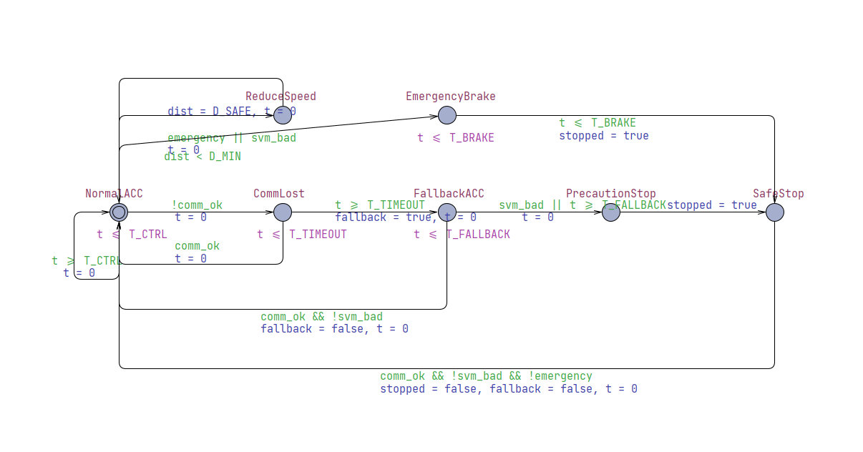
Task 4: Combined Control Model: Follower Control
– NormalACC is the main driving mode
– ReduceSpeed if distance is too small
– CommLost if wireless link fails
– FallbackACC after timeout
– EmergencyBrake or SafeStop if unsafe
Combined UPPAAL control model

Slide 10
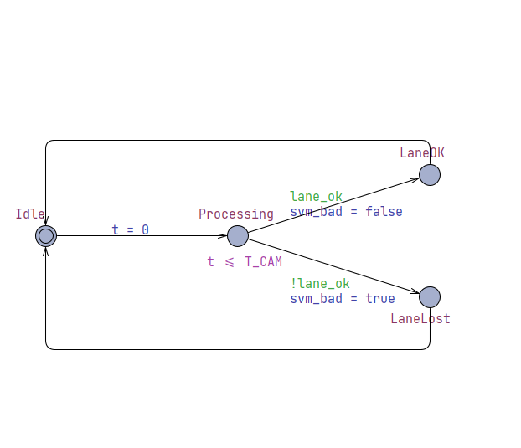
Task 4: Combined Control Model: Lane SVM
– Abstracts the SVM lane result
– Processing time: T_CAM = 33 ms
– lane_ok → normal lane detected
– !lane_ok → svm_bad = true
– Bad SVM result triggers safe control response

Slide 11
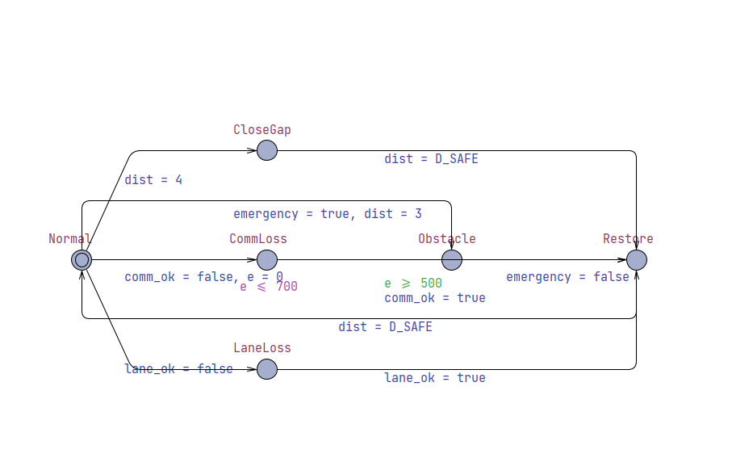
Task 4: Combined Control Model: Leader and Sensors
– Generates possible platooning situations
– CloseGap: distance becomes unsafe
– CommLoss: wireless link fails
– LaneLoss: camera/SVM loses lane
– Obstacle: emergency case
– Restore: system returns to normal

Slide 12
Summary
– SVM line follower, 5 steering classes
– 99% accuracy on balanced data
– Runs live in a ROS2 node
– 3 platooning scenarios modelled
– Combined control model (Task 4)
– All models deadlock-free
– Timing bounds always met
– Safe fallback on link failure
– Redundant braking, no single failure
– Minimum distance violation triggers safe control response

